Slide 1



MRC River Monitoring Technology Competition
Topic: Water Quality Monitoring System
Virbora NY, Socheata LEAVCHUM, Sokheang EANG
National Polytechnic Institute of Cambodia
Phnom Penh, Cambodia

Slide 2
Table of Contents
Introduction
Methodology
Design and Implementation
Hardware Design
Software Design
Prototype Testing
Conclusion
Reference

Slide 3
1. Introduction
Water Quality Monitoring System could collect and send real-time telemetry data from any water source. Using different types of sensors, the system can monitor the following data, such as:
Turbidity
PH (Potential of Hydrogen)
Dissolved Oxygen
Water Temperature

Slide 4
2. Methodology
Design Concept
A Solar Powered Monitoring System
Send Data from Measurement to the Server in Real-Time
Support Wired and Wireless Communication (Ethernet, GSM, LoRa)
Automatic Data Backup
Durable to Harsh Weather Conditions

Slide 5
2. Methodology
Solar Panel
Power Board
Main Controller
Sub Controller
Power
Management
Automatic Data Backup
RS485
RS485
Battery
Data Communication
Sensor Interface
LoRa WAN
GSM
pH
DO
Temperature
Turbidity
Sensor
Sensor
Sensor
Sensor
LoRa WAN
GSM
Server
2.1 System Block Diagram

Slide 6
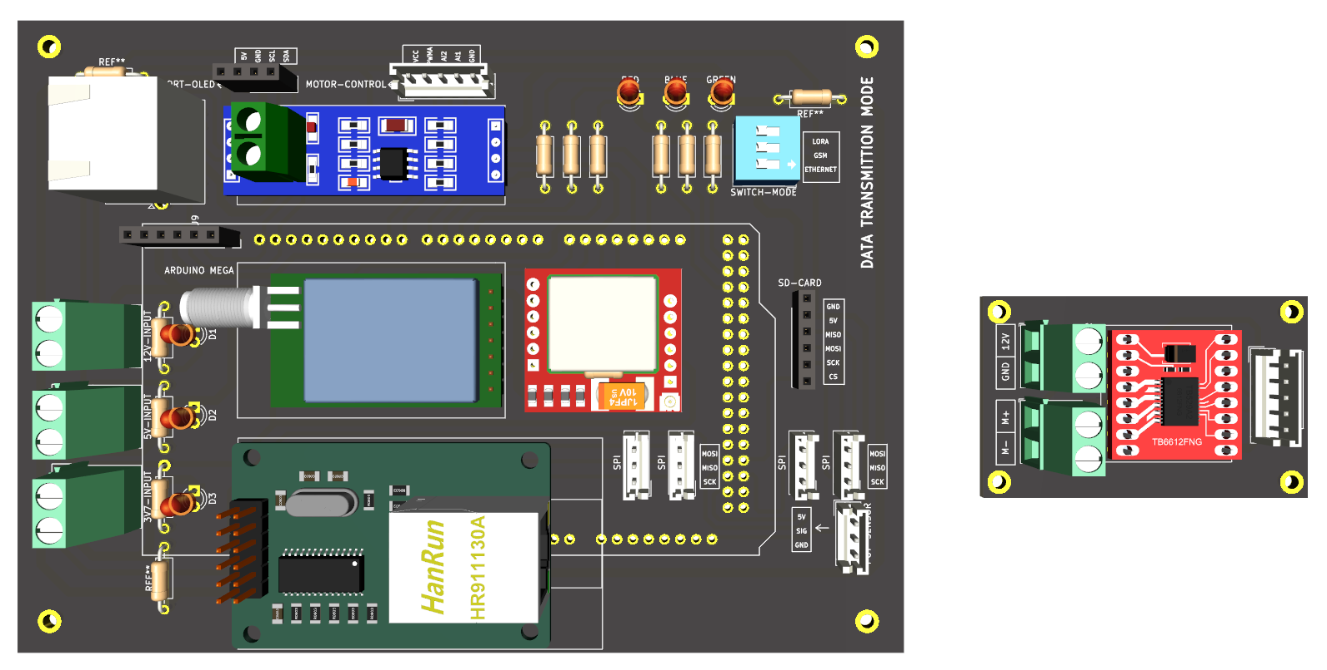
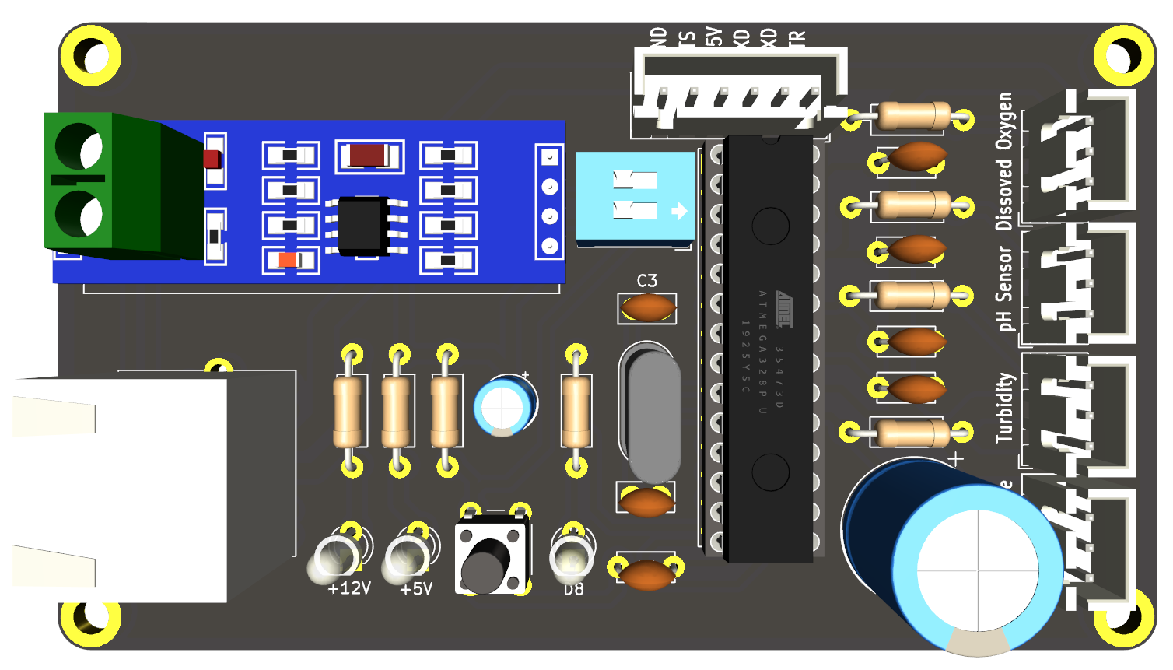
3. Design and Implementation
Hardware Design
(a) Main System Hardware
(b) Sub System Hardware
3.1 PCB Hardware Design

Slide 7
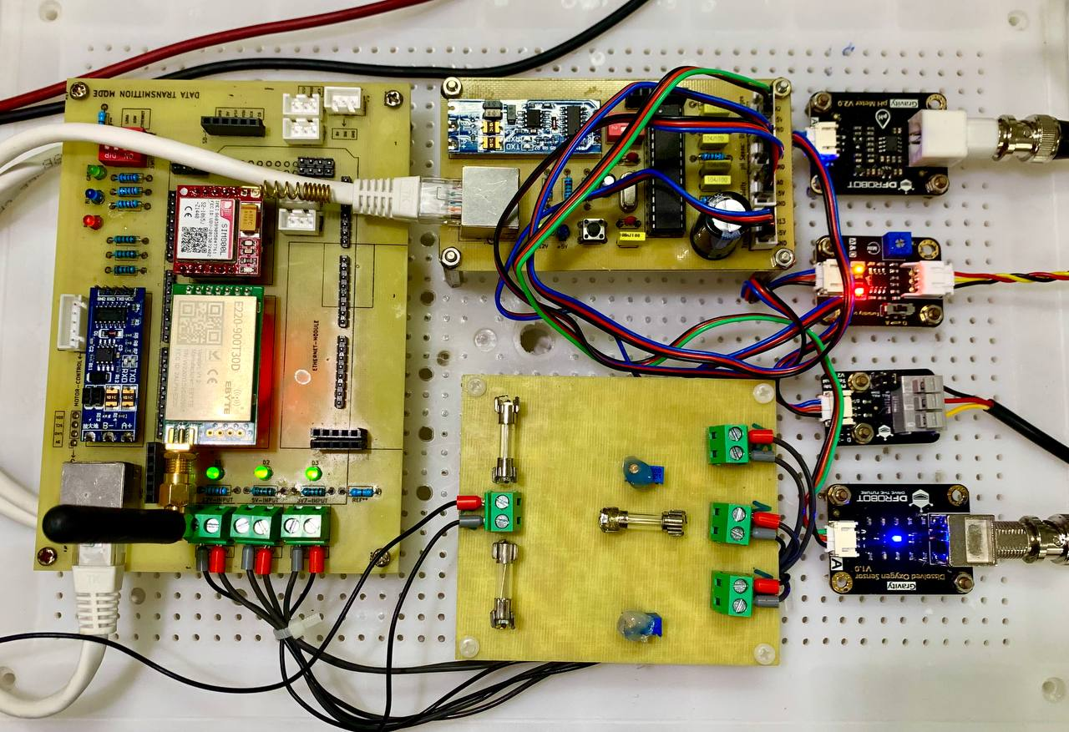
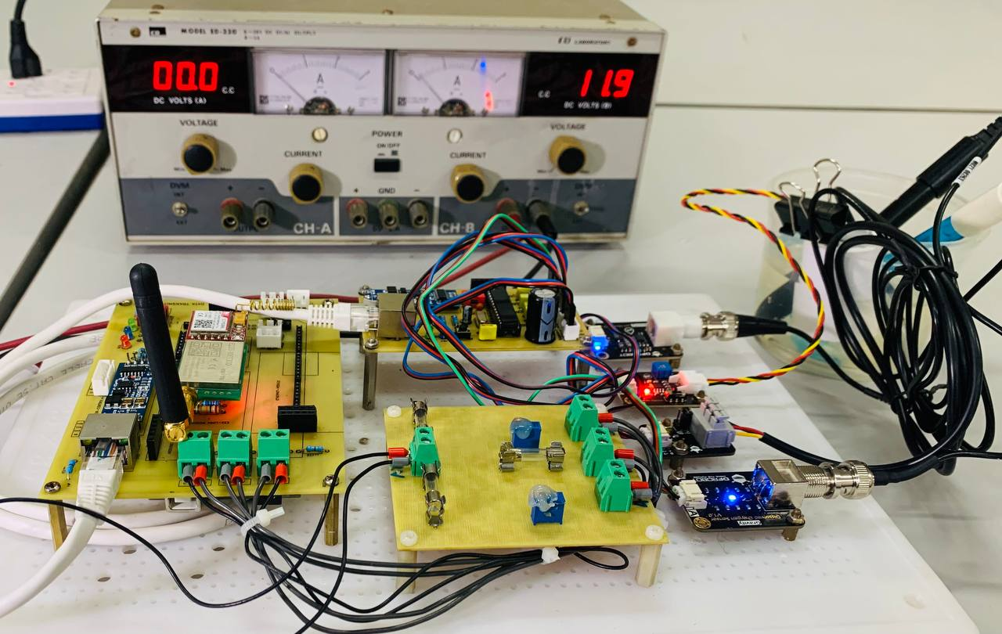
3. Design and Implementation
Hardware Design
2
3
1
3.2 Main Hardware Implementation
Notes:
1. Power Management Board

Slide 8
3. Design and Implementation
Software Design
Software Architecture
Data Backup
Communication
Sensor Interface
•
Data Recovery When Losing
•
Wired and Wireless
•
Dissolved Oxygen
Communication
•
GSM
•
PH
•
LoRa
•
Turbidity
•
Ethernet
•
Temperature
3.3 Software Architecture Diagram

Slide 9
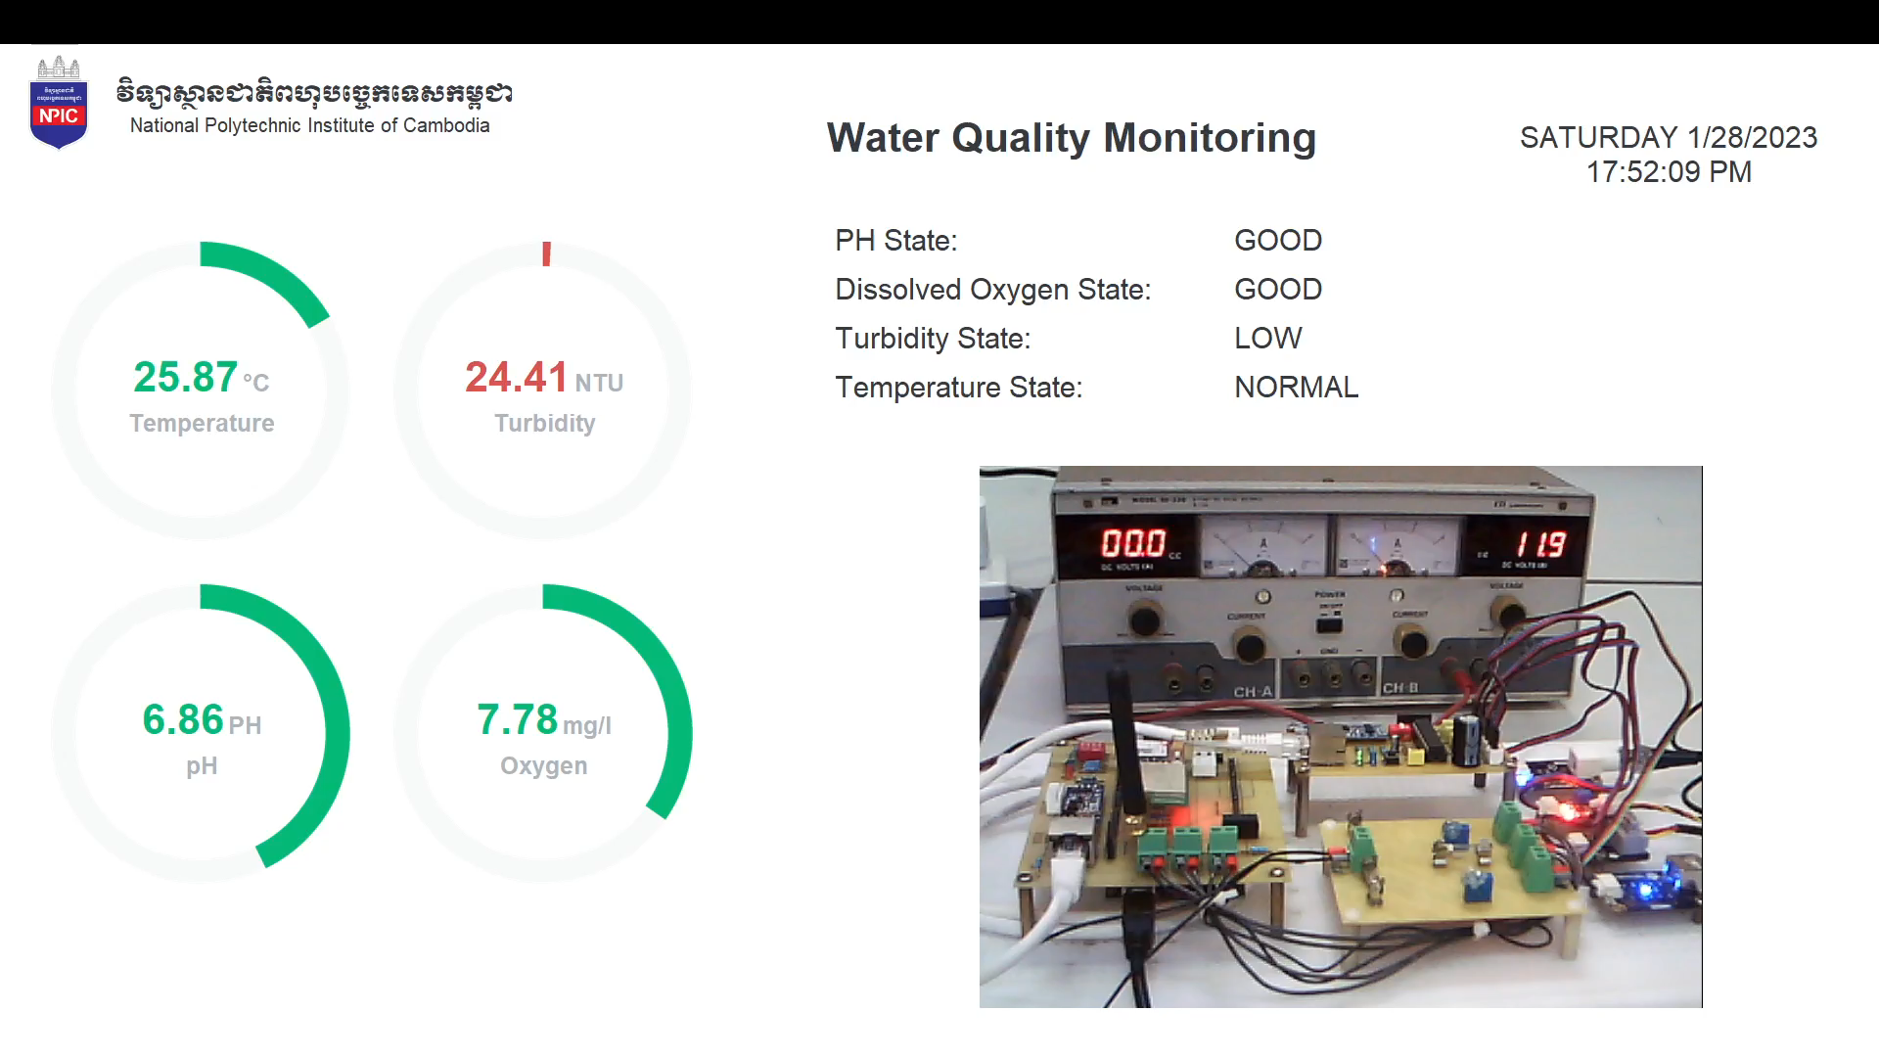
4. Prototype Testing
4.1 Prototype Testing Video with UI Design

Slide 10
5. Conclusion
In conclusion, the system could collect data and display the value in real-time on the computer. However, some sensors take up to three minutes for each sampling, which could lead to some measurement delays.
Future Work Includes
Solar Tracker
Wireless Communication
Automatic Data Backup System

Slide 11
Reference
[1]. MRC. (2018). 2016 Lower Mekong Regional Water Quality Monitoring Report . Vientiane: MRC Secretariat.
https://doi.org/10.52107/mrc.ajg6r1
[2]. World Health Organization. (‎2017)‎. Water quality and health - review of turbidity: information for regulators and
water suppliers. World Health Organization. https://apps.who.int/iris/handle/10665/254631. License: CC BY-
NC-SA 3.0 IGO
[3]. “Dissolved oxygen (DO) | A monitor's Guide to Water Quality.” [Online]. Available:
https://datastream.org/en/guide/dissolved-oxygen. [Accessed: 28-Jan-2023].
[4]. “Data Portal,” MRC. [Online]. Available: https://portal.mrcmekong.org/time-series/dissolved-oxygen.
[Accessed: 28-Jan-2023].
[5]. MRC. (2021). Situation Report on Dry Season Hydrological Conditions in the Lower Mekong River Basin:
November 2020–May 2021. Vientiane: MRC Secretariat. https://doi.org/10.52107/mrc.qx5yo1
[6]. MRC. (2022). Mekong Low Flow and Drought Conditions in 2019–2021. Vientiane: MRCnSecretariat.
https://doi.org/10.52107/mrc.qx5yo7
[7]. MRC. (2021). Technical Guidelines on the Implementation of the Procedures for Water Quality . Vientiane: MRC
Secretariat. https://doi.org/10.52107/mrc.ay2l12

Slide 12
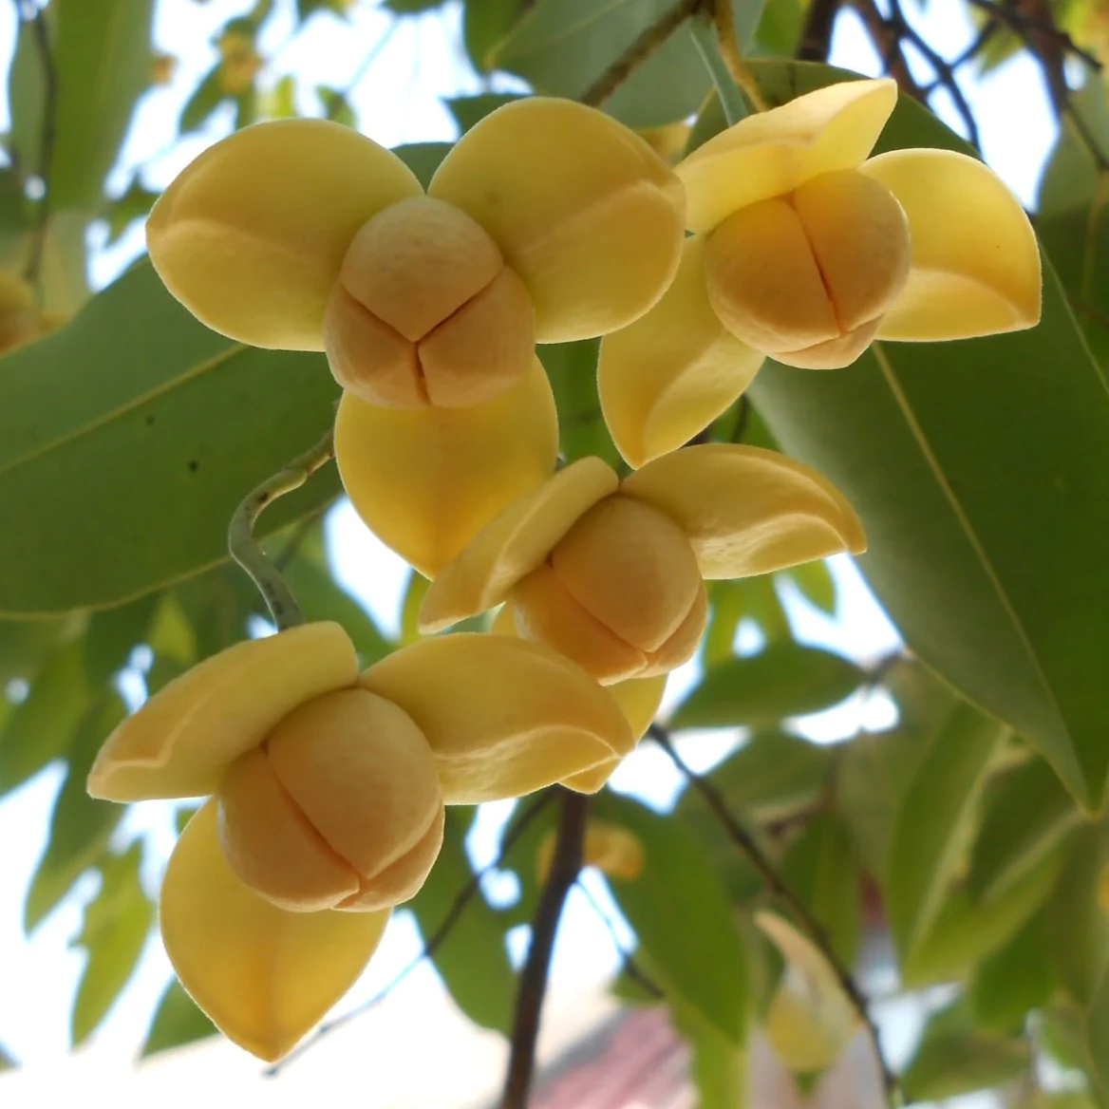
សូមអរគុណ
Thank You

